Slide 1

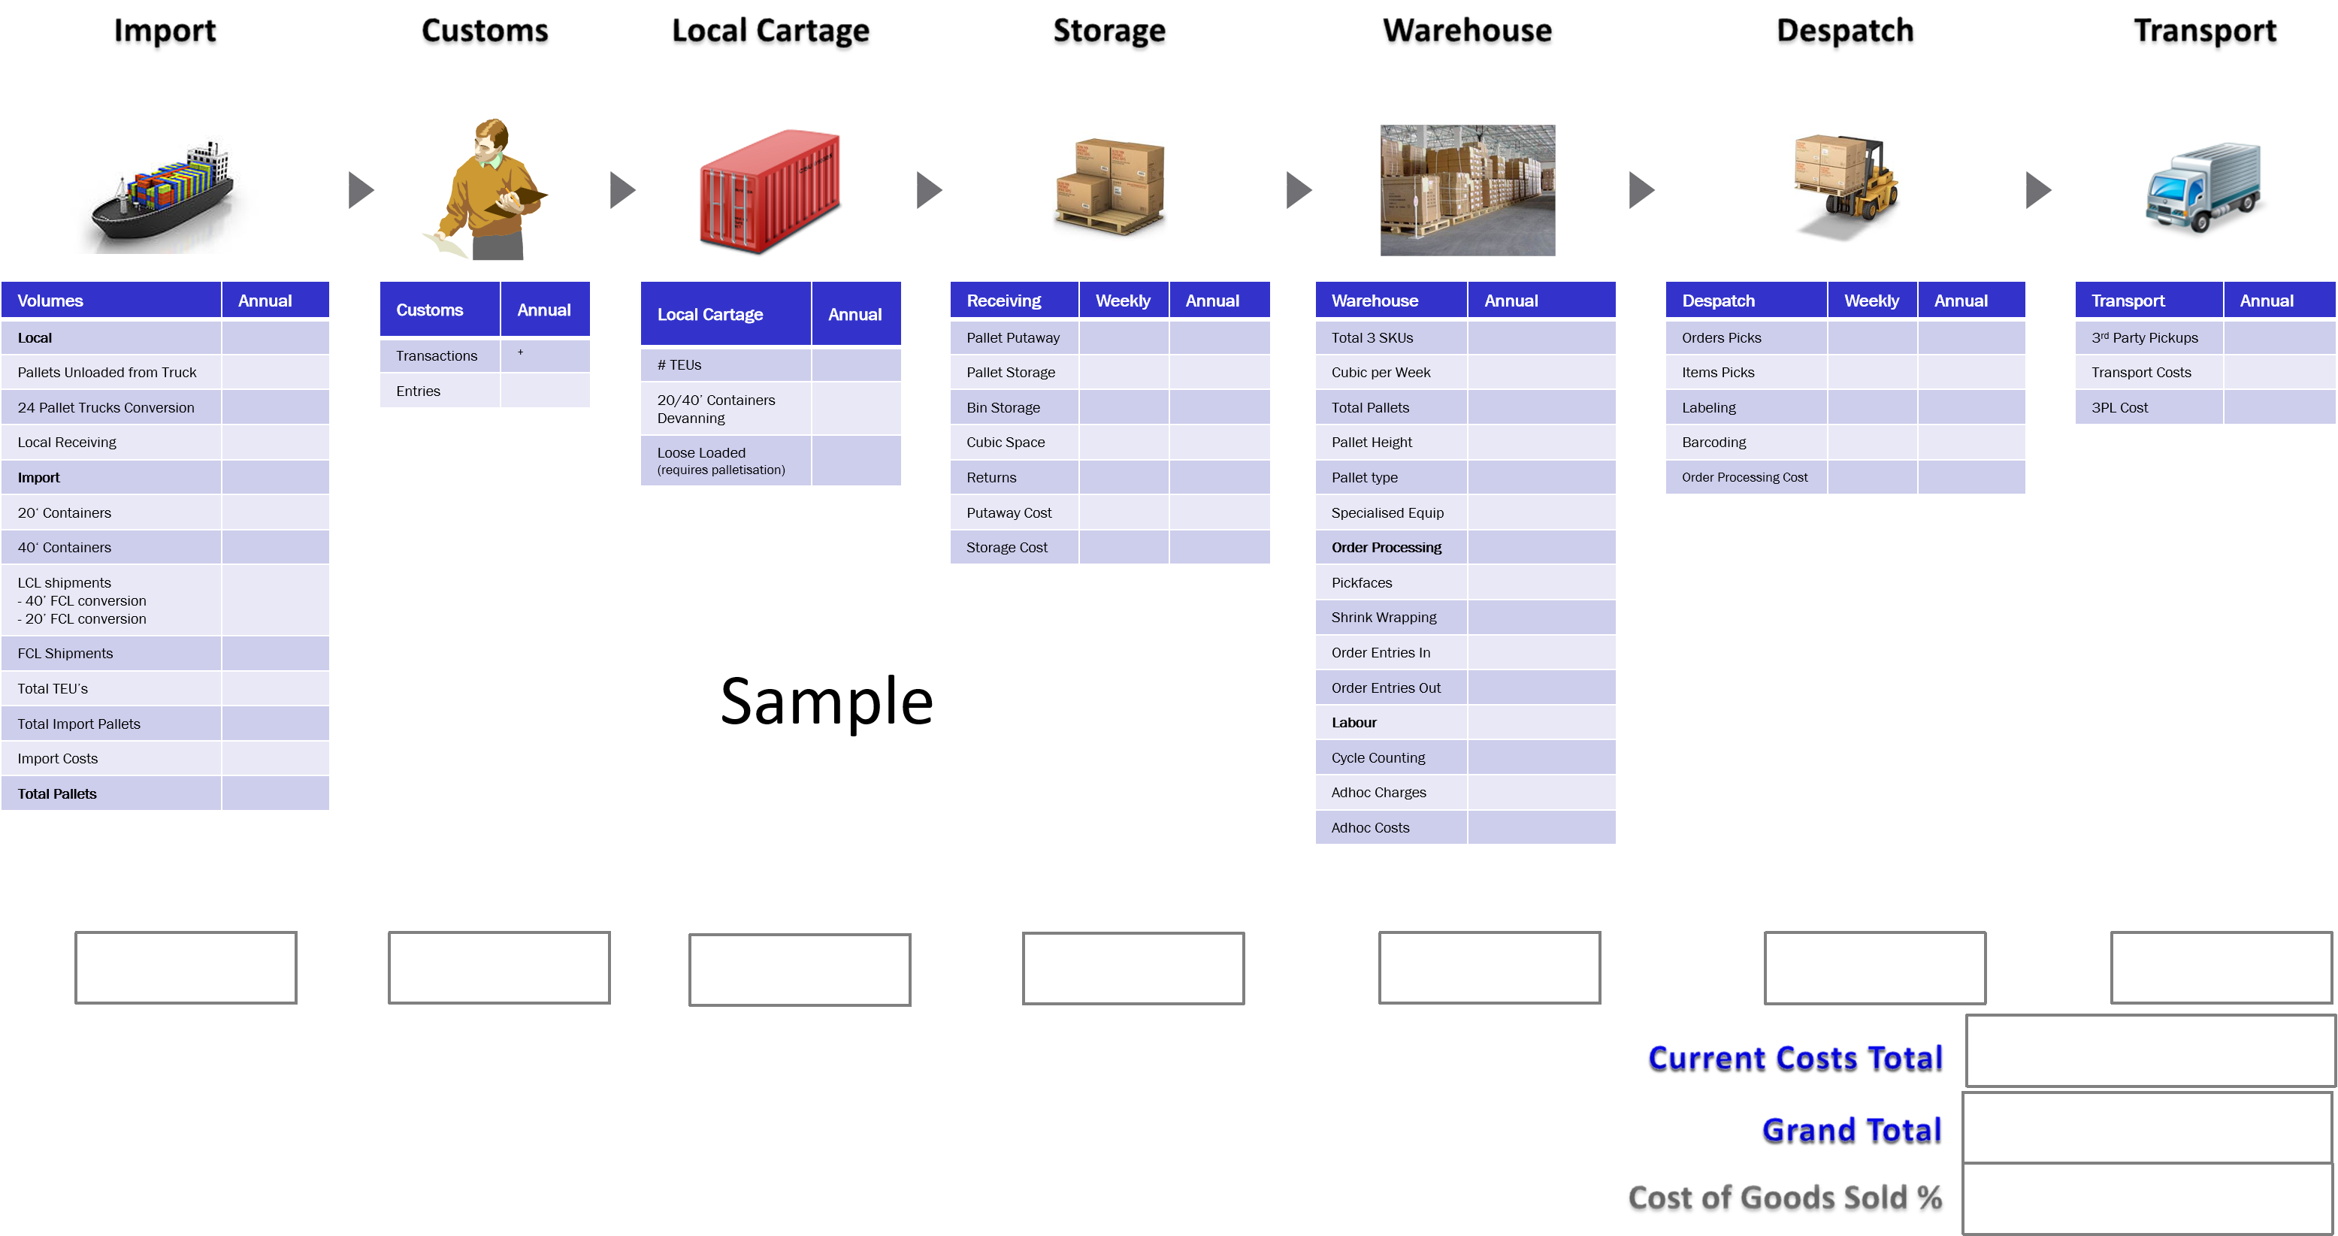
Supply Chain Cost Model Melbourne

